Slide 1

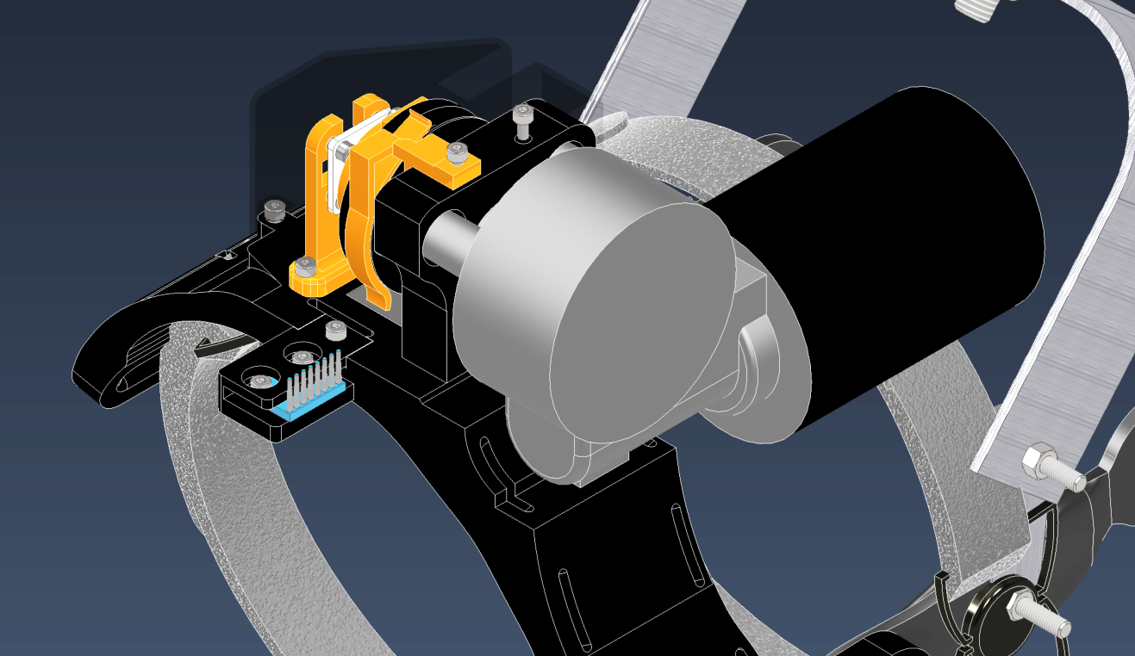
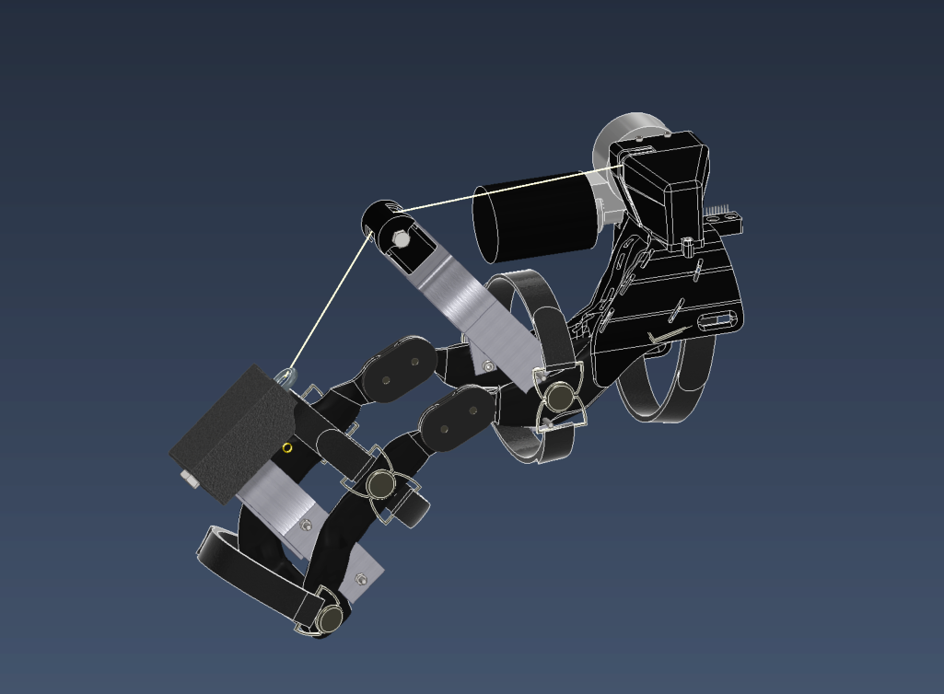
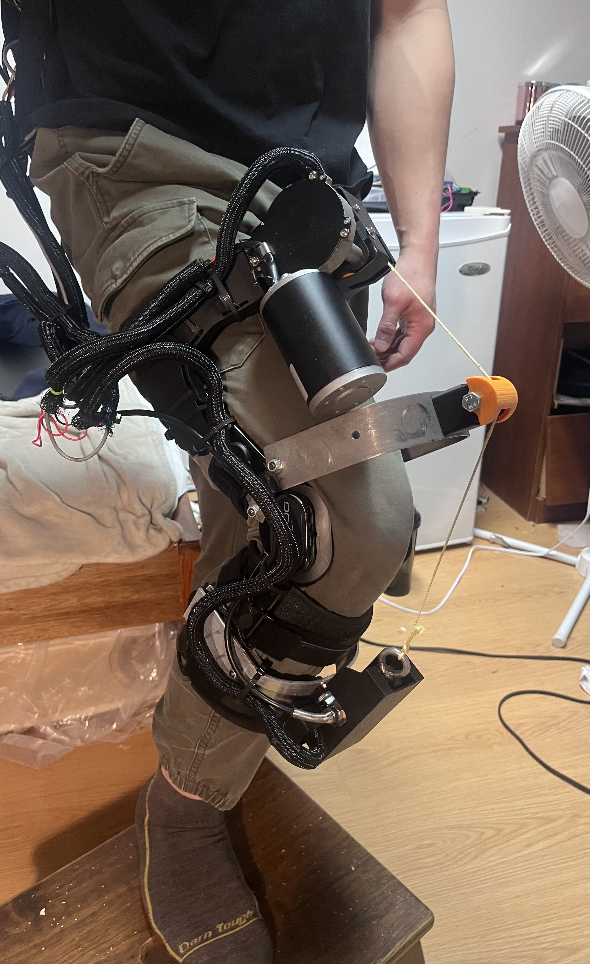
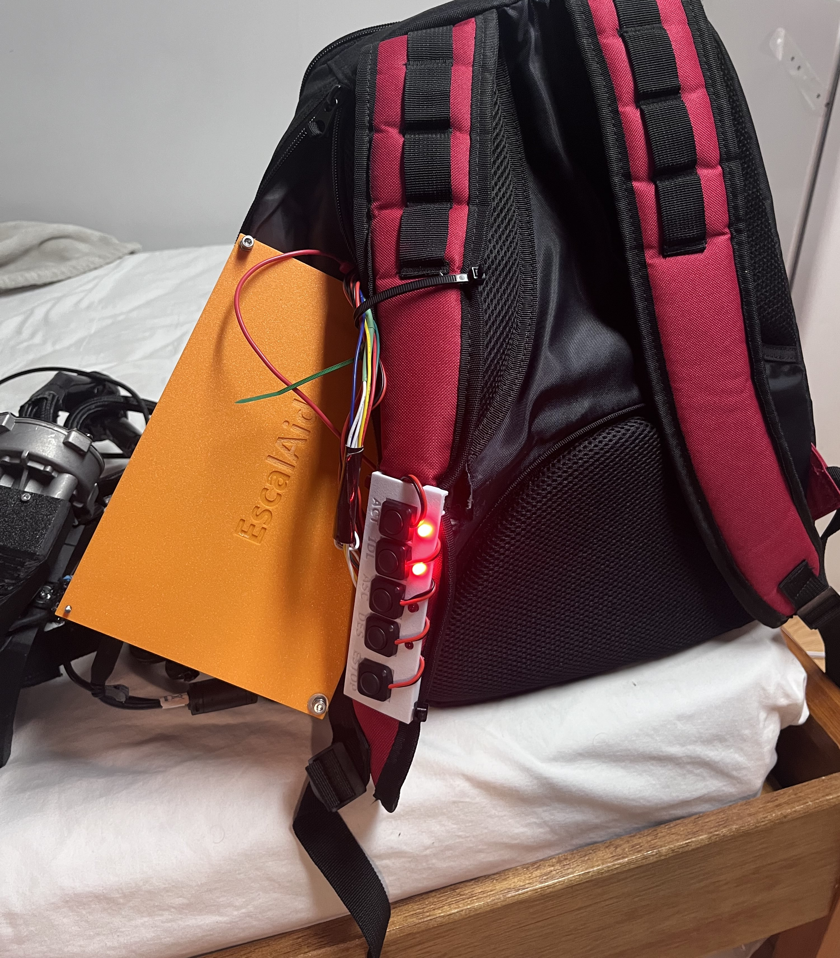
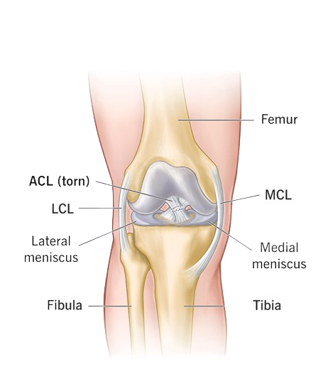
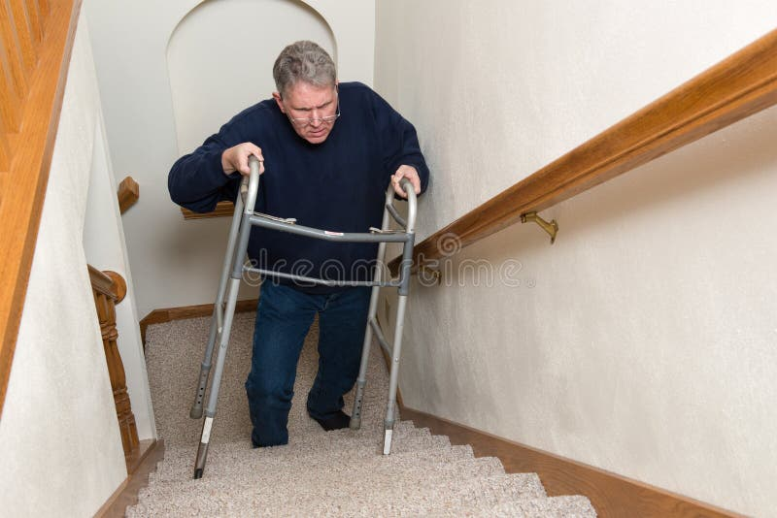
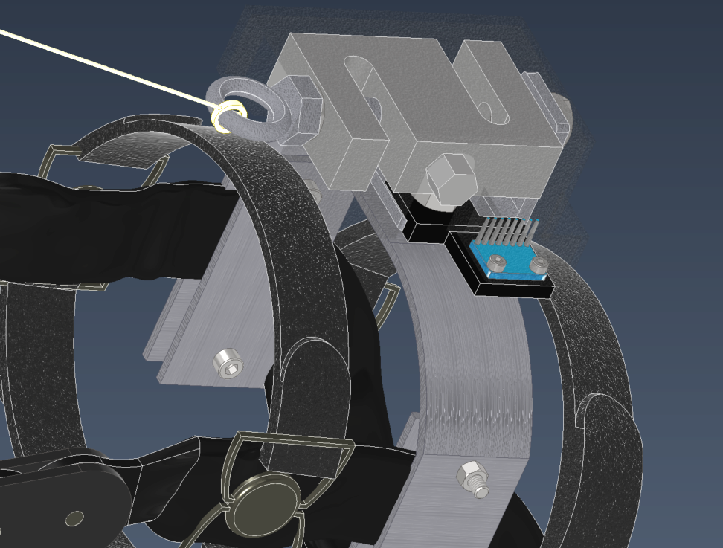
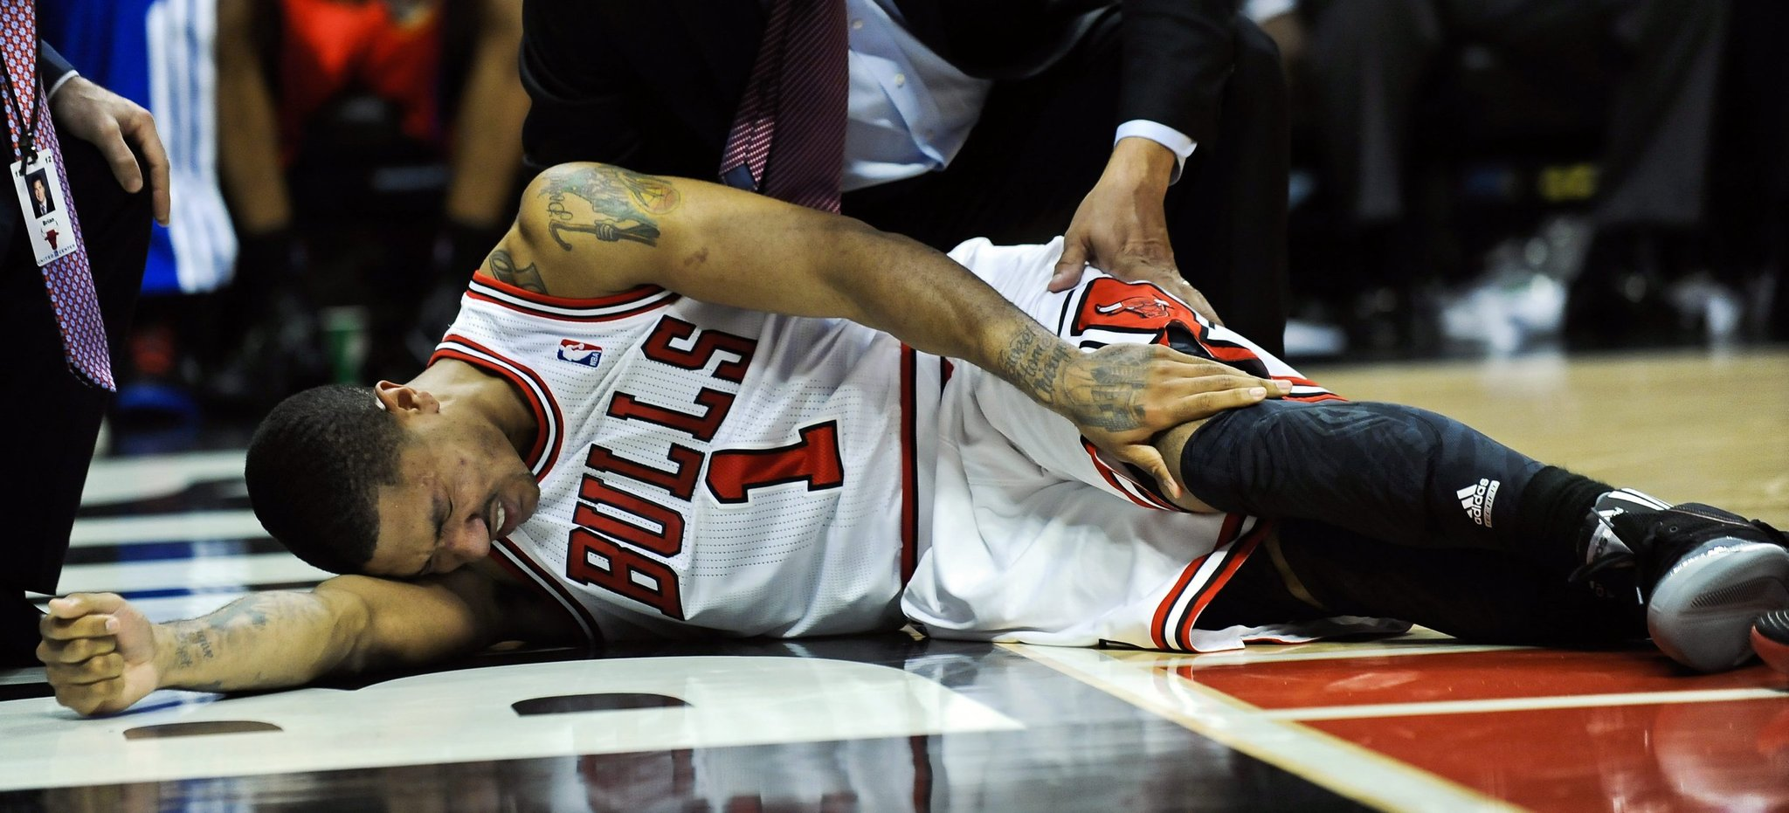
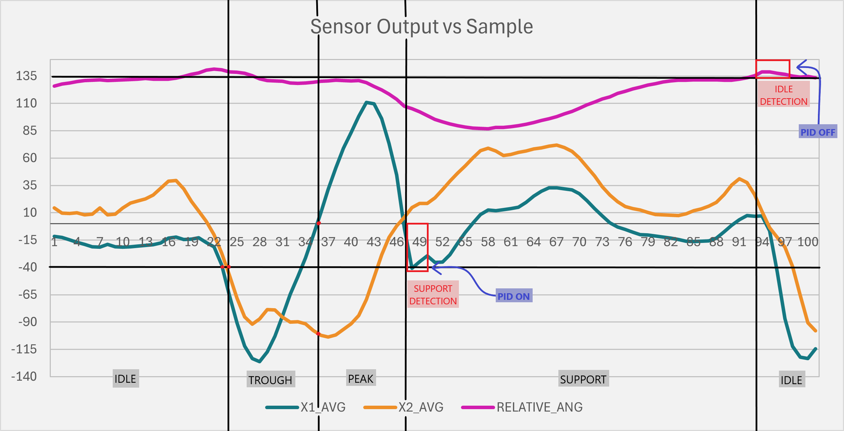
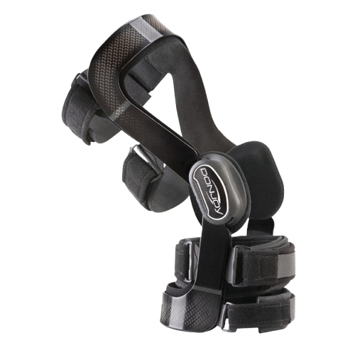
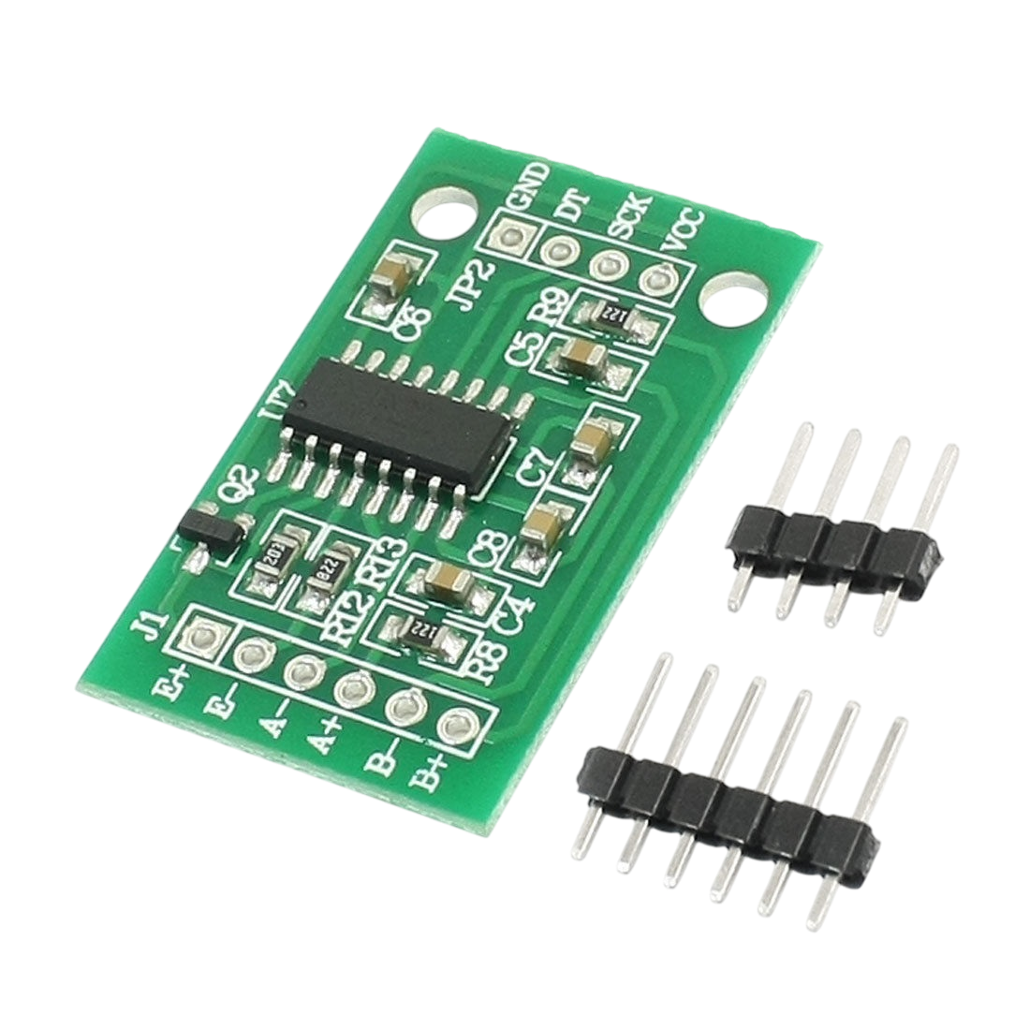
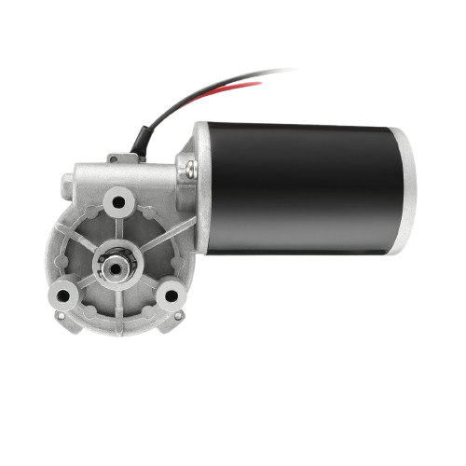
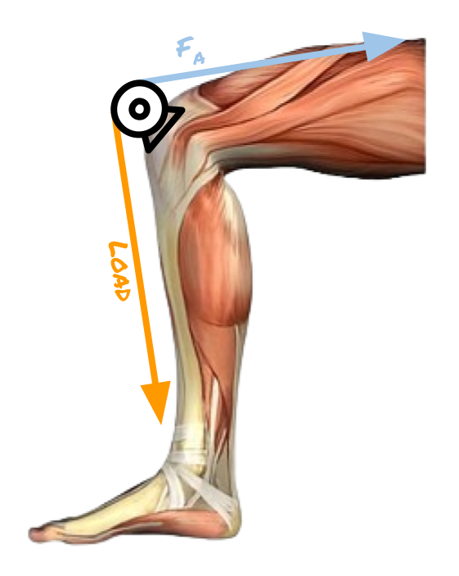
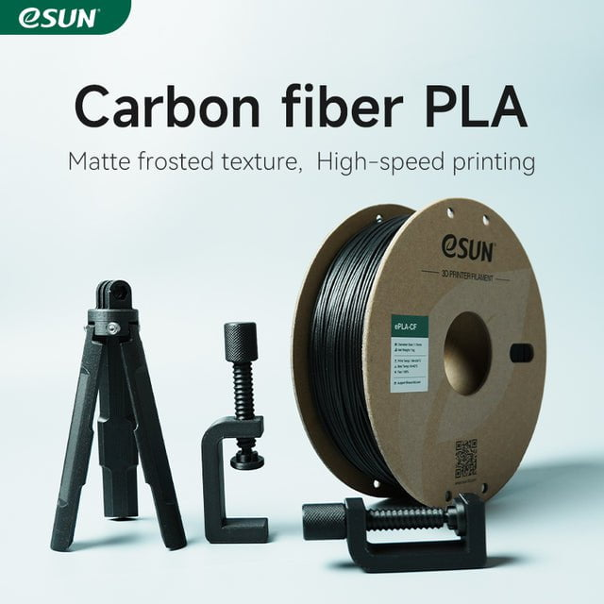
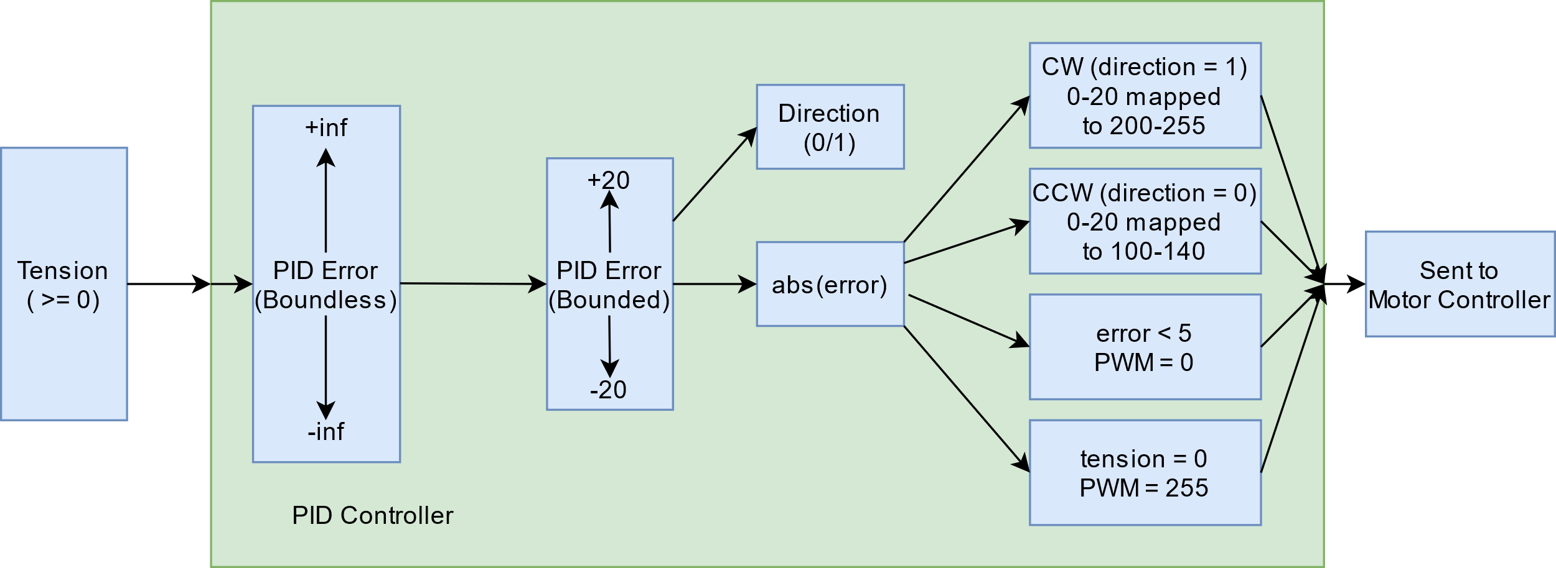
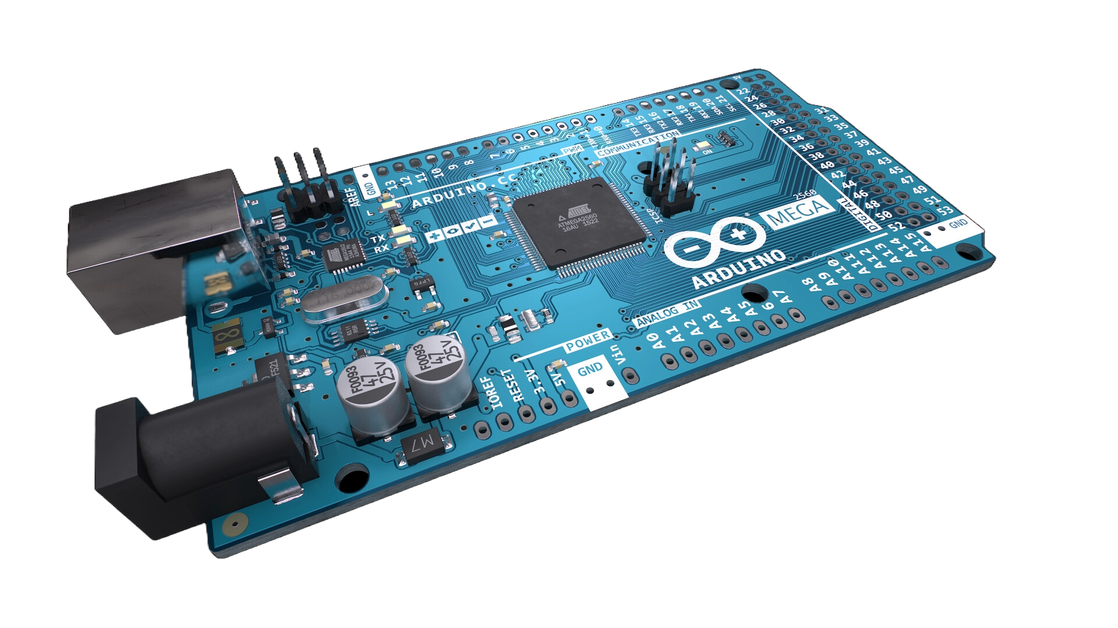
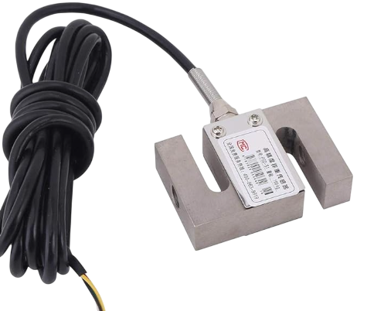
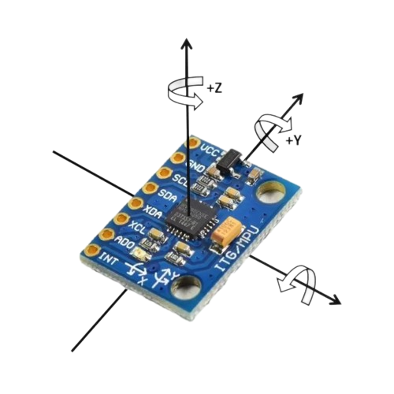
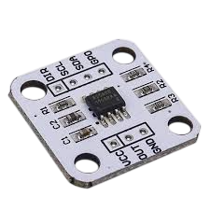

EscalAid
Ram Arunan, Alex Bartella, Ethan Cavallin, Peter Kosir, Ryan Lee
Computing and Software Mechatronics Capstone Project
WHAT IS IT?
MOTIVATION
Daily wearable electrically powered knee brace that provides support for users while climbing stairs
Targets to support up to 40% of the user’s weight while ascending stairs
Helps make life more comfortable for people who experiences pain in their knees while walking up stairs
Specifically, aims to ease and rehabilitate injuries like ACL, MCL, LCL tears and reduce pain from chronic knee issues such as tendinopathy and tendonitis
HOW IT WORKS
SOFTWARE
HARDWARE
MECHANICAL
Based on user input, the movement data is used to determine the state of motion and drive motor controls. PID controller actively adjusts motor movement using the tension sensor for user intent, providing 60lbs of support through the step-up portion of the climb.
Primary hardware includes two IMUs serve to constantly collect movement data, while tension sensor determines how much force needs to be applied (via PID). High torque worm gear motor provides the force, and hall effect sensor determines motor position. An Arduino Mega 2560 serves as the controller of the device.
Winch System with a motor, a cable, a pulley and an anchor point that is used to pull the leg up during ascension. Emulates a tendon-muscle system. Low profile, lightweight brace mount was designed from the ground-up to house hardware.

